Slide 1
Assignment 2-A TurtleBot3 Burger Teardown
GROUP 1
Chinmay Vilas Samak
Tanmay Vilas Samak
GitHub Repository

Slide 2
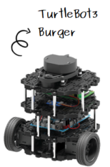
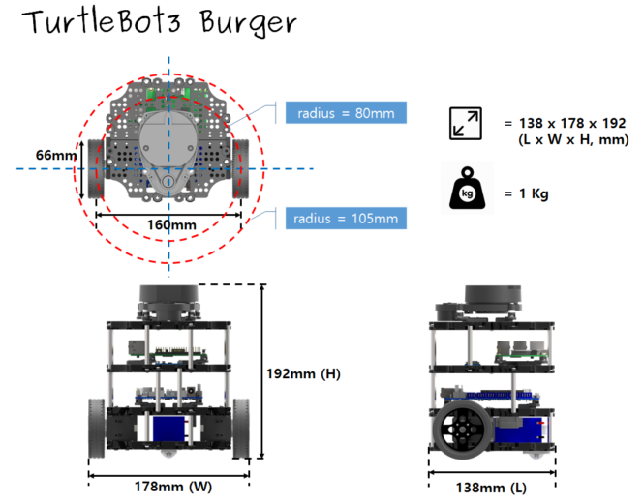
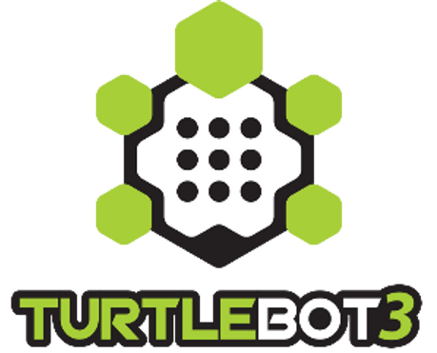
Feature Overview
Differential drive mechanism
Small form factor
Multi-mode actuators
Multi-sensor lineups
Affordable cost
Open hardware
Open firmware
Open software
ROS enabled
Source: ROBOTIS Inc.

Slide 3
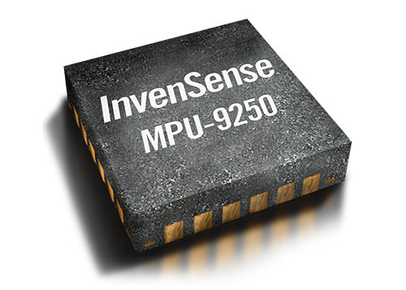
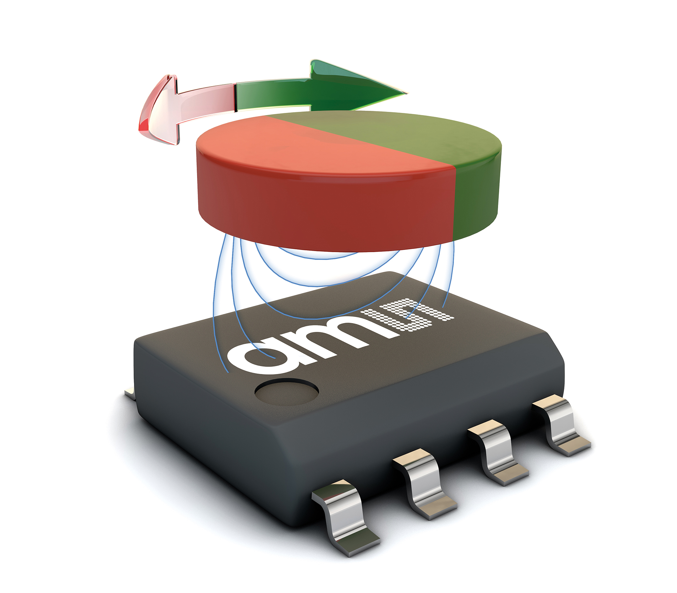
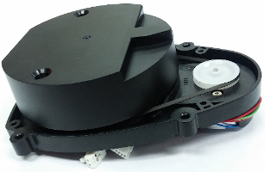
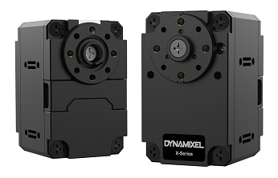
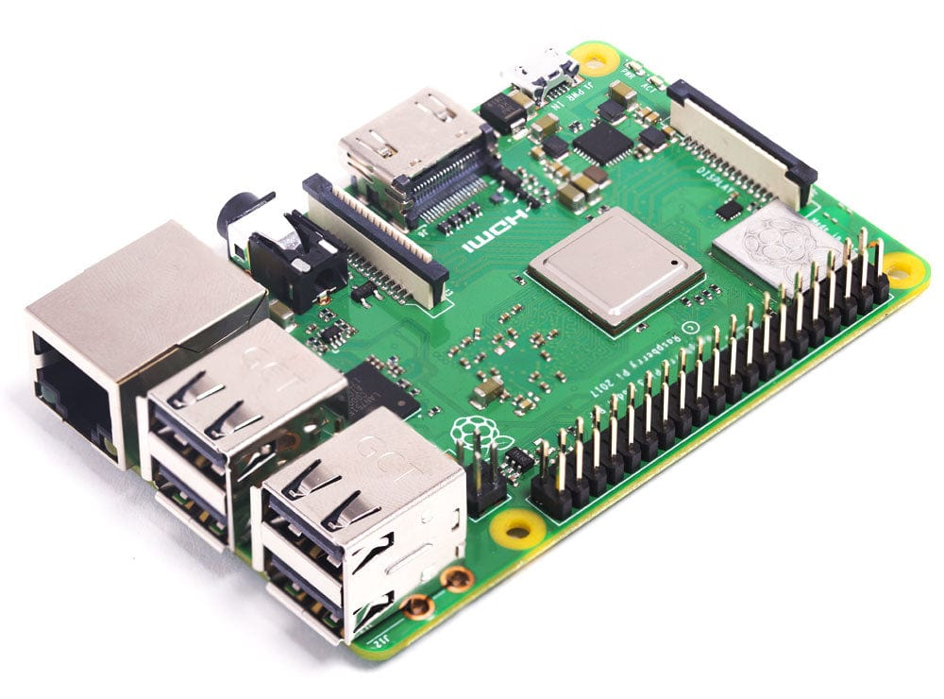
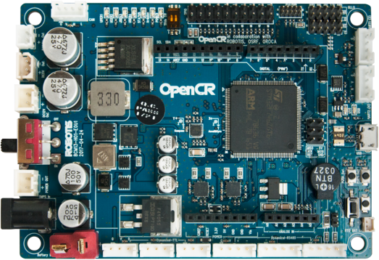
Existing Hardware
Note: The TurtleBot3 Burger provided in class has add-on Pi Camera v2
Sensors:
LDS-01 360° planar LiDAR*
MPU-9250 9-axis IMU**
AS5601 magnetic absolute encoders
Actuators:
DYNAMIXEL XL430-W250-T continuous rotation servos (CRS)
Computers:
Raspberry Pi 3B+ single board computer (SBC)***
OpenCR1.0 auxiliary low-level controller board
*LDS-02 is applied since 2022.
**9-axis MPU-9250 IMU has been replaced with 6-axis ICM-20648 IMU since 2020.
***Raspberry Pi 3 Model B+ is applied since 2019. Earlier model is equipped with Raspberry Pi 3 Model B. Raspberry Pi 4 Model B is applied since 2021 September.

Slide 4
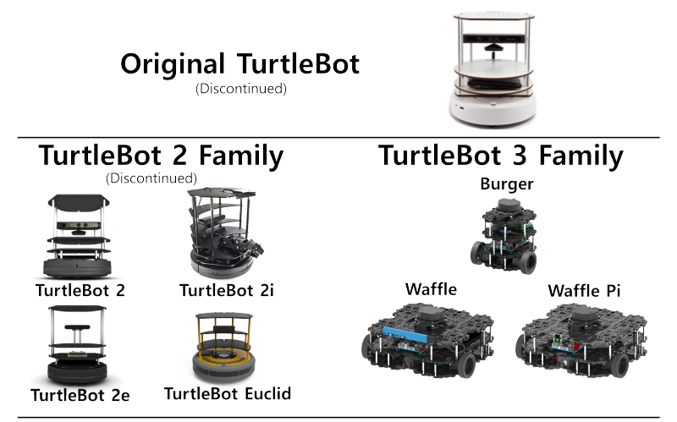
TurtleBot Version Comparison
TurtleBot Version | Mobile Base | Battery Pack | Computer(s) | Sensor(s) | Actuator(s) | Developer(s) | Release Date
TurtleBot1 | iRobot Create | 3000 mAh | Asus 1215N Laptop | Gyro, MS Kinect (RGBD-Cam), Encoders | iRobot Create Robot Base Motors | Willow Garage | Nov 2010
TurtleBot2 | Yujin Kobuki | 2200 mAh | Asus 1215N Laptop | Gyro, MS Kinect (RGBD-Cam), Encoders | Yujin Kobuki Robot Base Motors | Willow Garage | Oct 2012
TurtleBot3 | Burger, Waffle, Waffle Pi | 1800 mAh | Raspberry Pi (or Intel Joule 570x), OpenCR1.0 | 2D LiDAR, 9-Axis IMU, Encoders, Pi Camera (Mono-Cam), Intel RealSense RGBD-Cam | DYNAMIXEL Servo Motors | ROBOTIS, OSRF | May 2017
TurtleBot1: Costs $1400, large, less flexibility, deprecated
TurtleBot2: Costs $1500, huge, less modular, deprecated
TurtleBot3: Costs $650, small, modular, continued support
Robotis and OSRF Announce TurtleBot 3 Smaller, Cheaper, and Modular (IEEE Spectrum, By Evan Ackerman, 12 Oct 2016)
Source: IEEE Spectrum
Source: TurtleBot.com

Slide 5
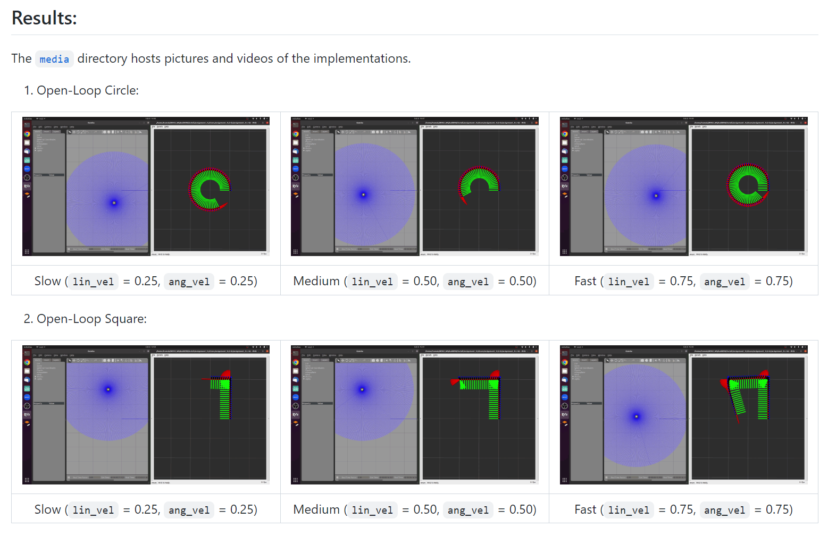
Analysis
Parameter/Metric | Slow Circle | Slow Square | Medium Circle | Medium Square | Fast Circle | Fast Square
Resemblance to ideal trajectory | Very High | Low | High | Medium | Medium | Extremely Low
Kinematic behavior | Very High | High | High | Medium | Medium | Very Low
Time for 1 complete traversal | High | Very High | Medium | Medium | Very Low | Low
Note 1: The analysis presented above is qualitative.
Although a detailed quantitative analysis can be accomplished, it was beyond the scope of this assignment.
Note 2: The physical TurtleBot3 has a maximum travel speed of 0.22 m/s and maximum rotational speed of 2.84 rad/s.
The simulated TurtleBot3 was operated at higher limits to analyze the effect of simulation dynamics on the
performance of the open-loop controllers designed.
Note 3: Deployment videos as well as pictures are available in README.md file as well as in the media directory of the
assignment repository.
Source: Tinker Twins GitHub

Slide 6
Thank You!

